Slide 1
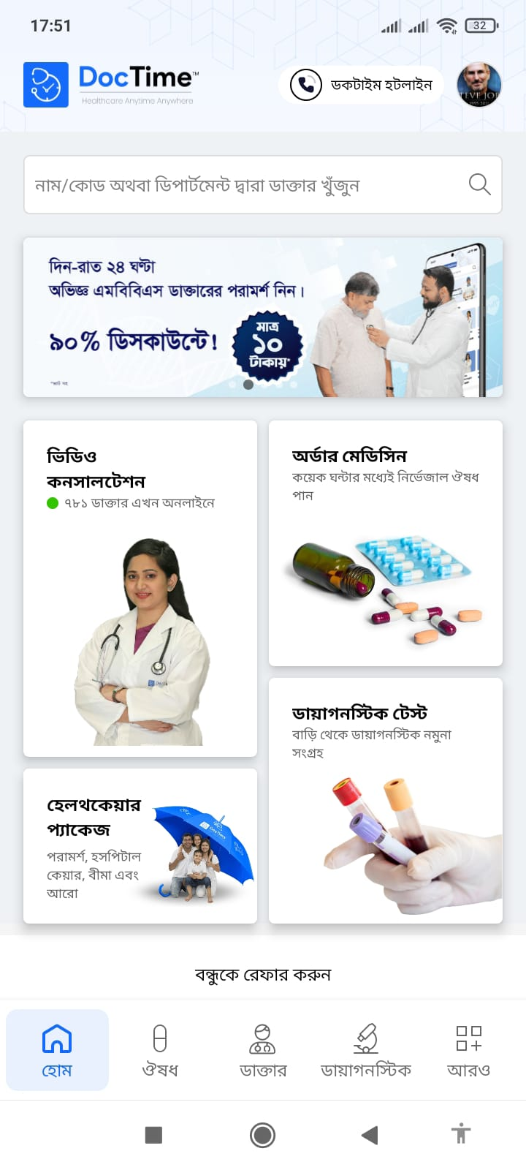
Home Page

Slide 2
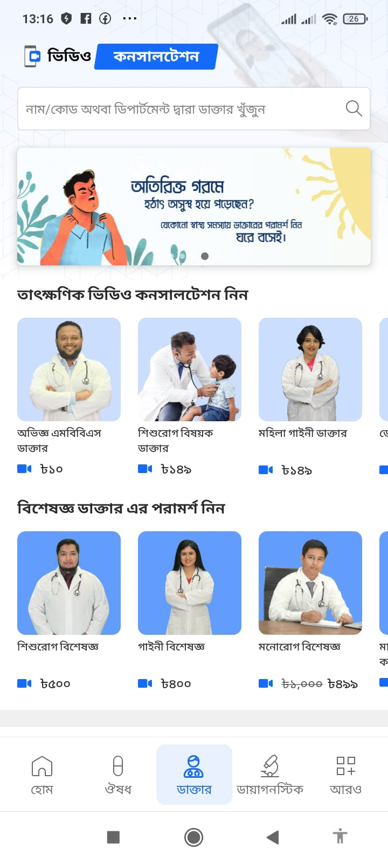
Doctor Page

Slide 3
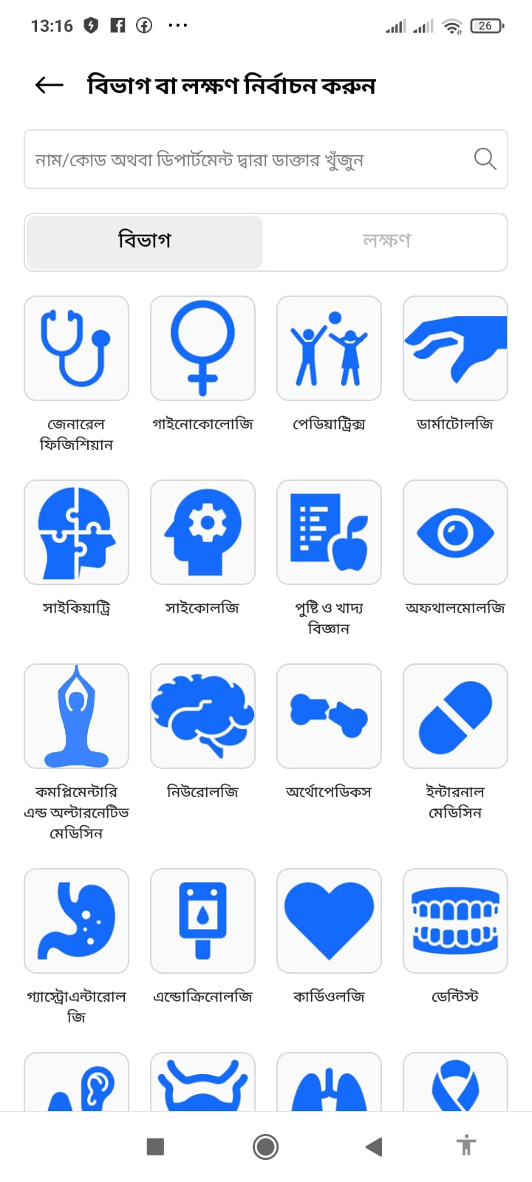
Service Page

Slide 4

Symptoms Page

Slide 5
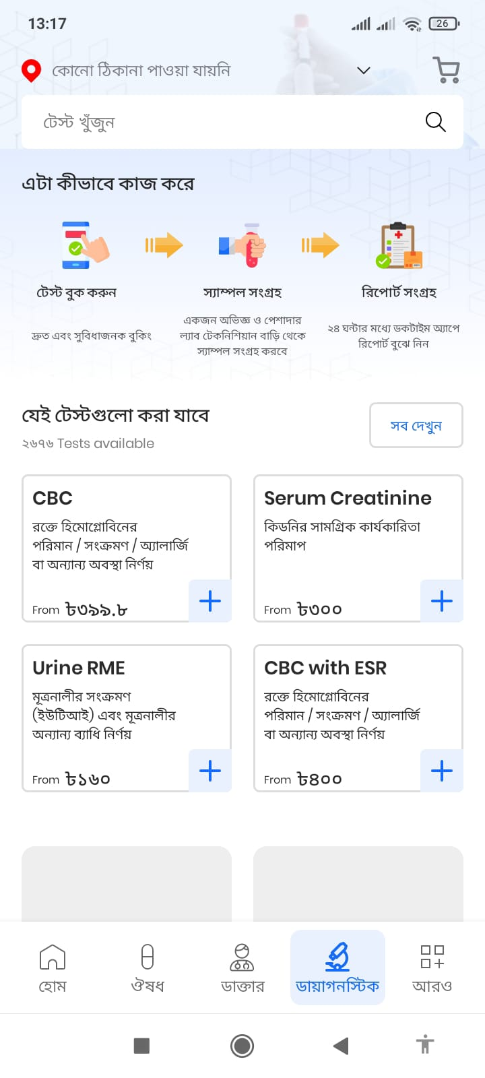
Diagnostics Page

Slide 6
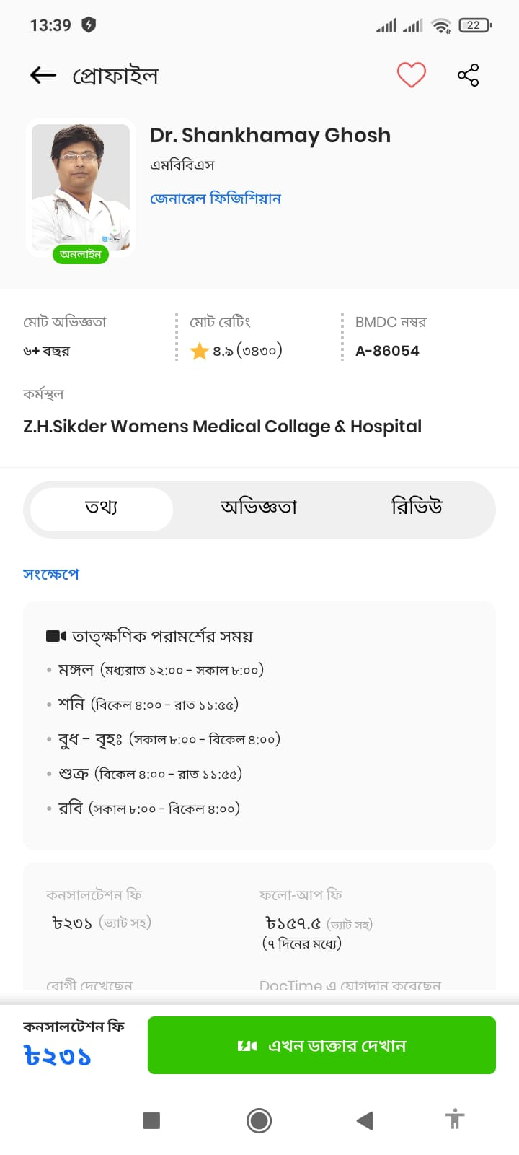
Doctor profile Page

Slide 7
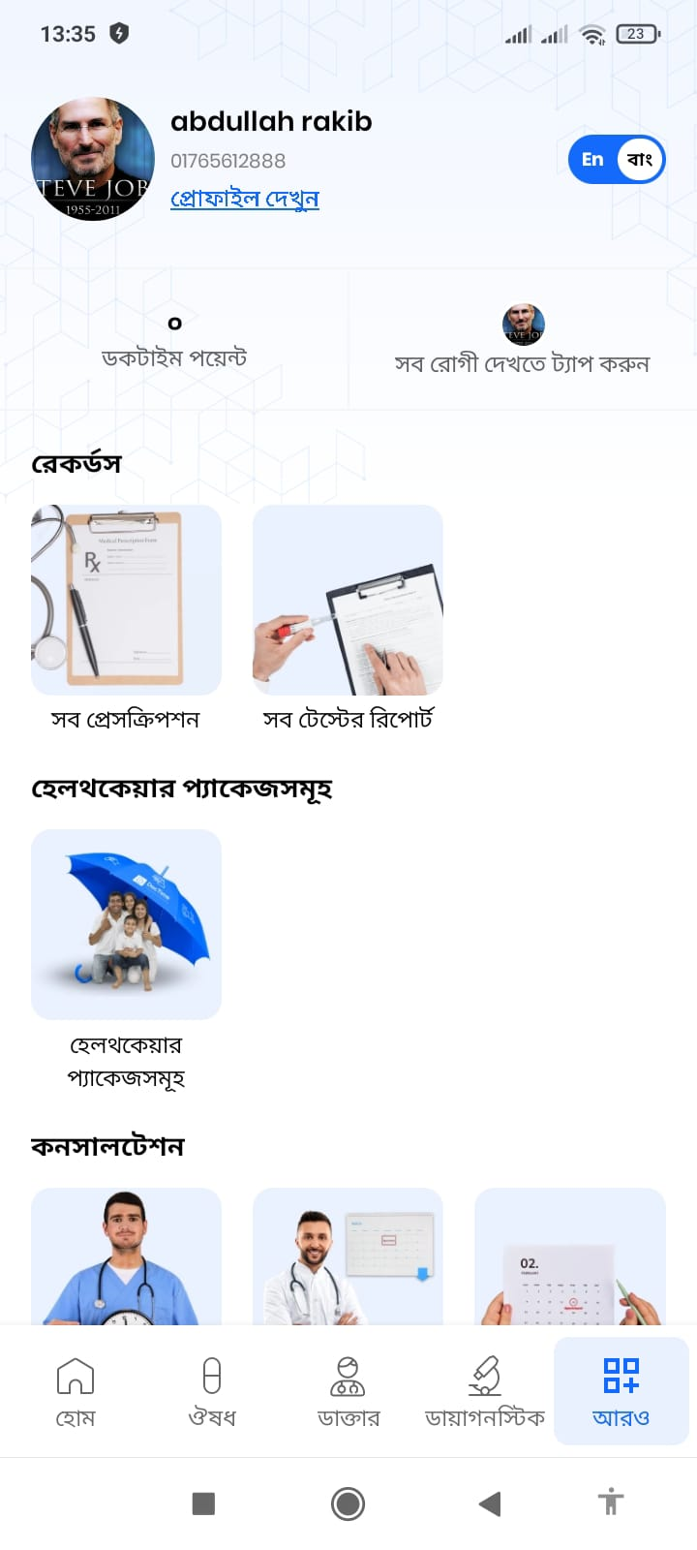
User profile Page

Slide 8
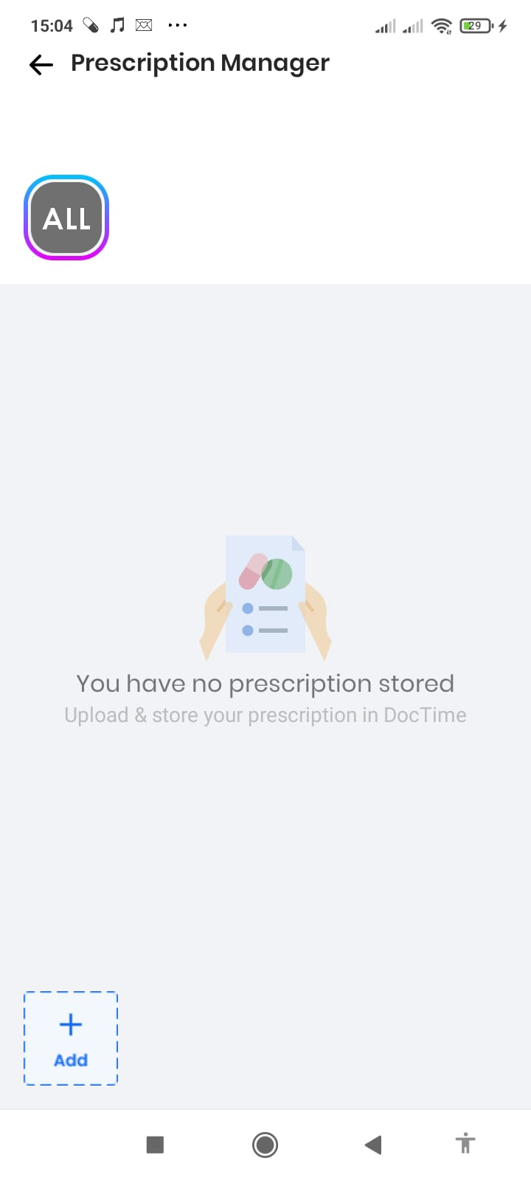
Prescription Page

Slide 9
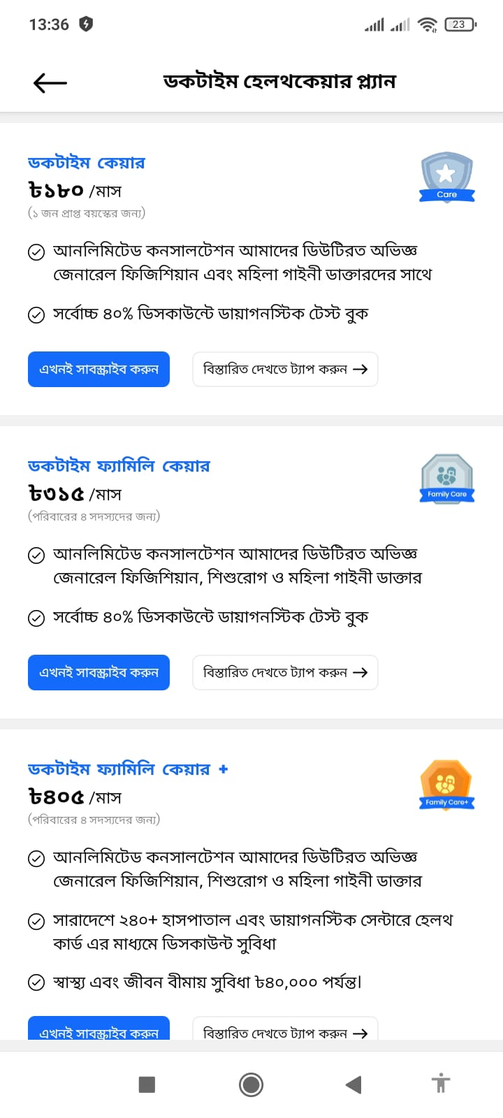
Healthcare plan Page

Slide 10
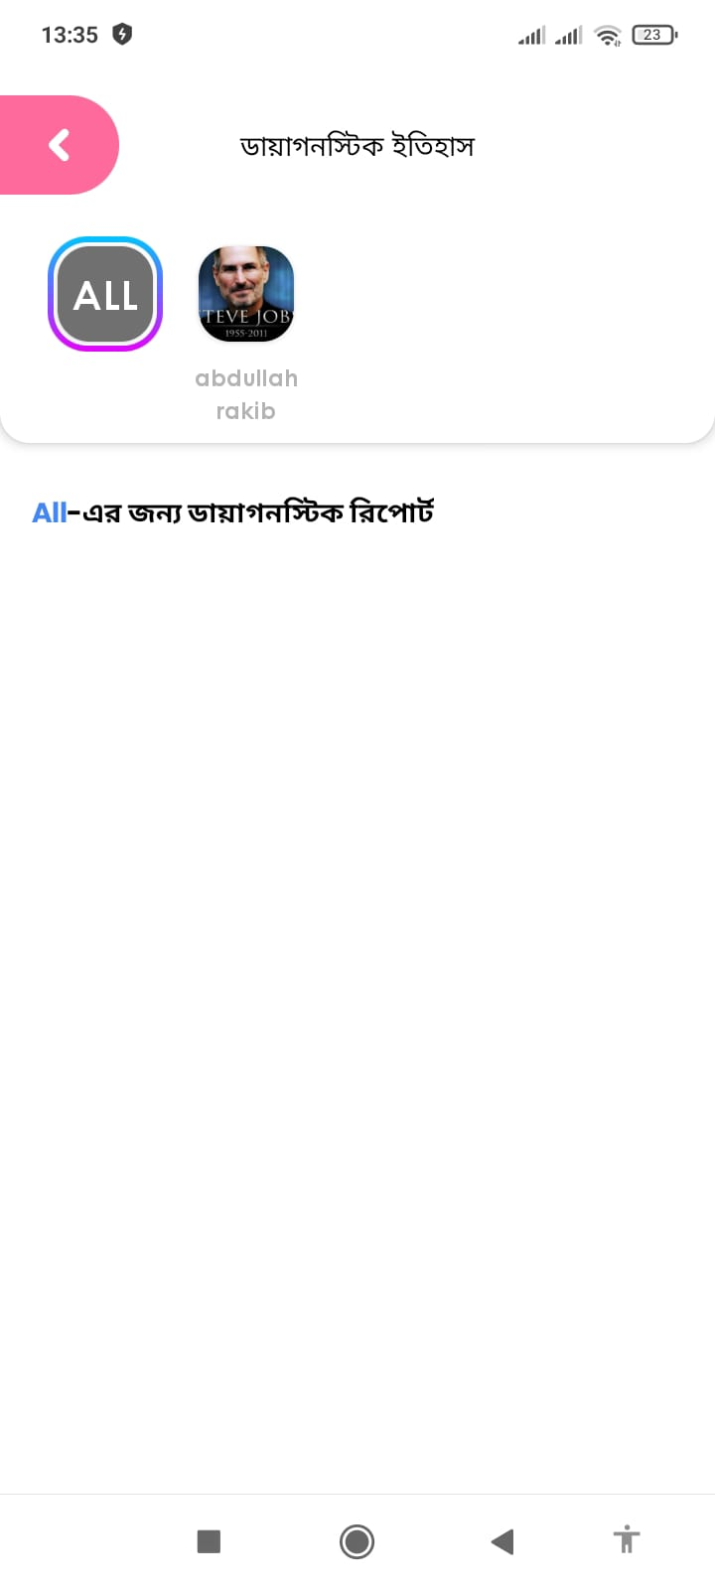
Diagnostic Report Page

Slide 11
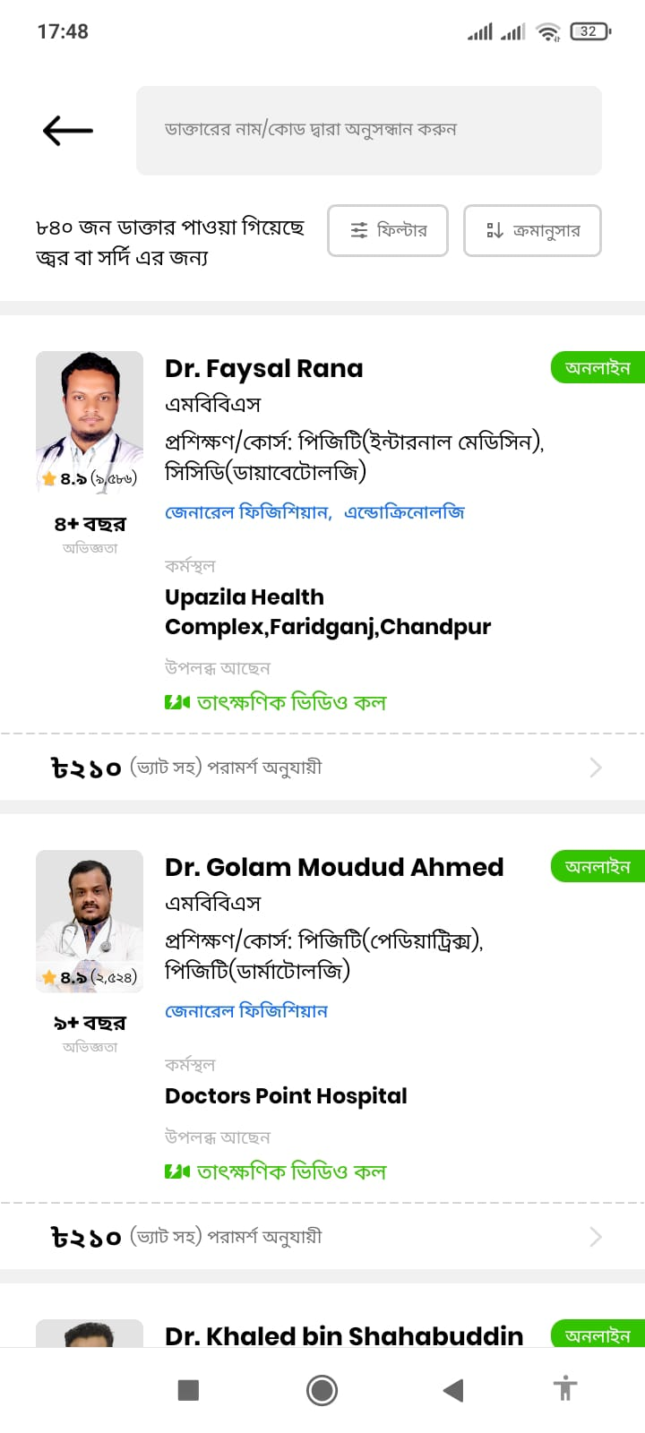
Doctor list Page

Slide 12

Doctor Page

